Slide 1
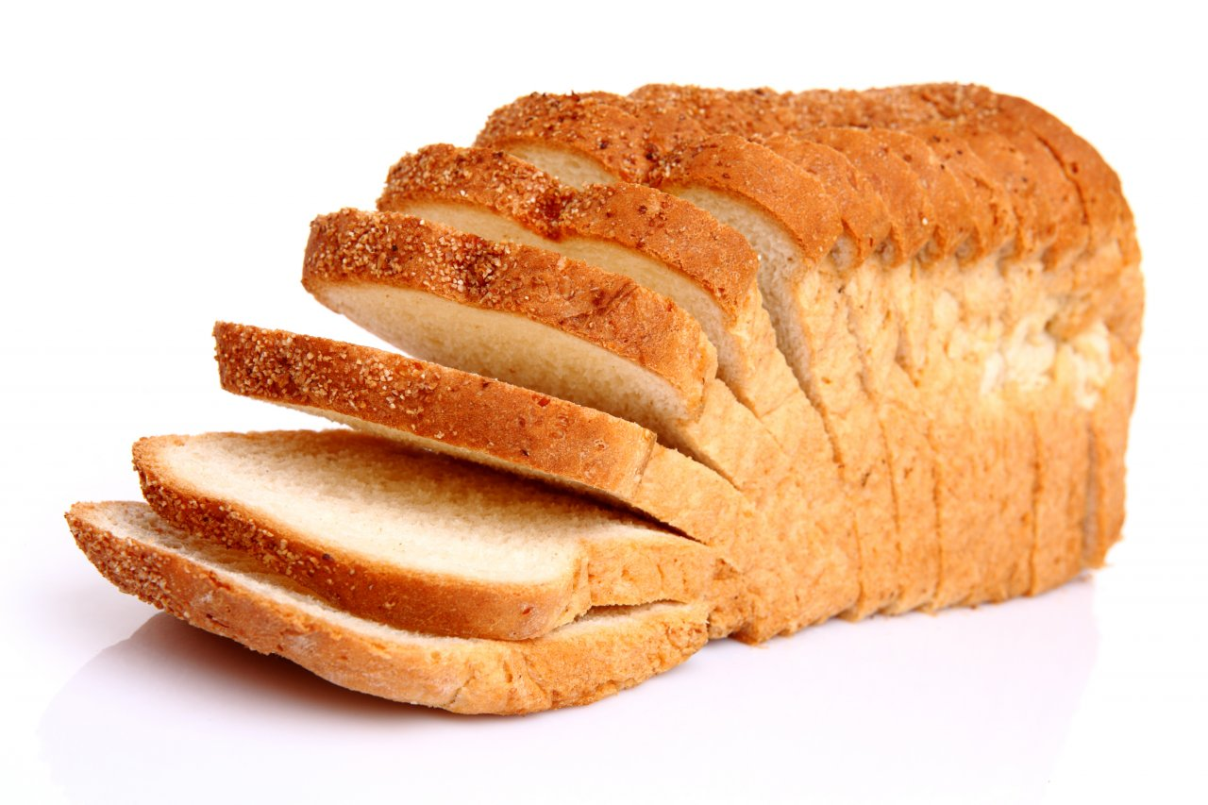
λ
vs.

Slide 2
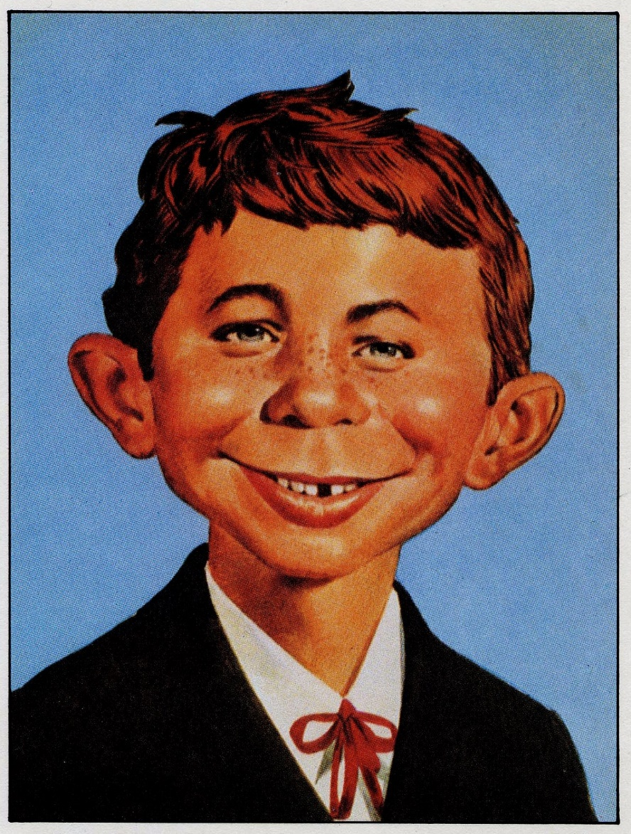
What,
me worry?

Slide 3


Slide 4
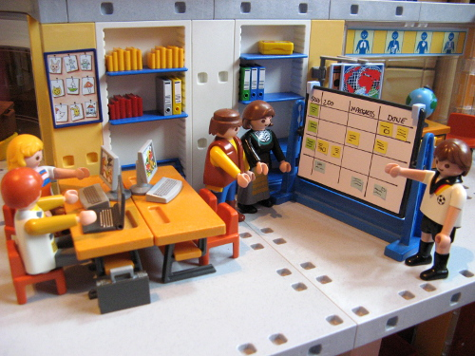

Slide 5


Slide 6
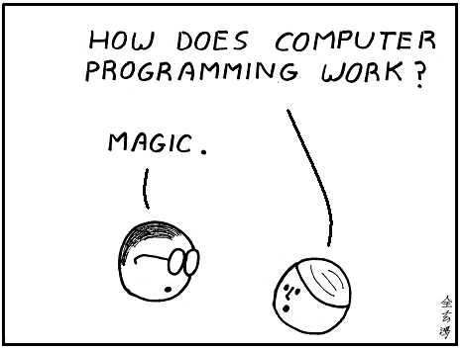

Slide 7


Slide 8
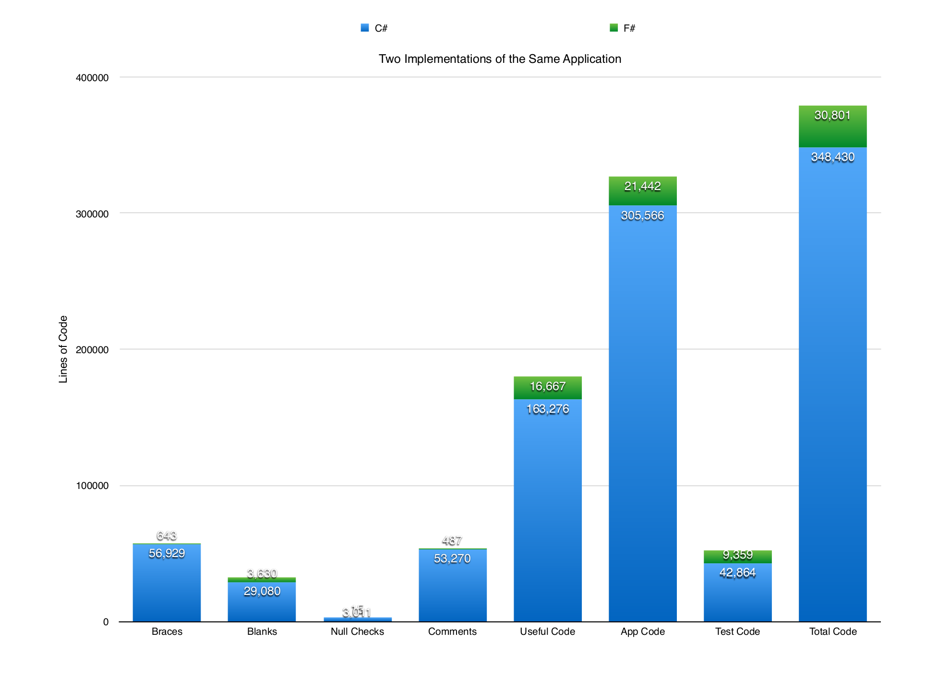

Slide 9
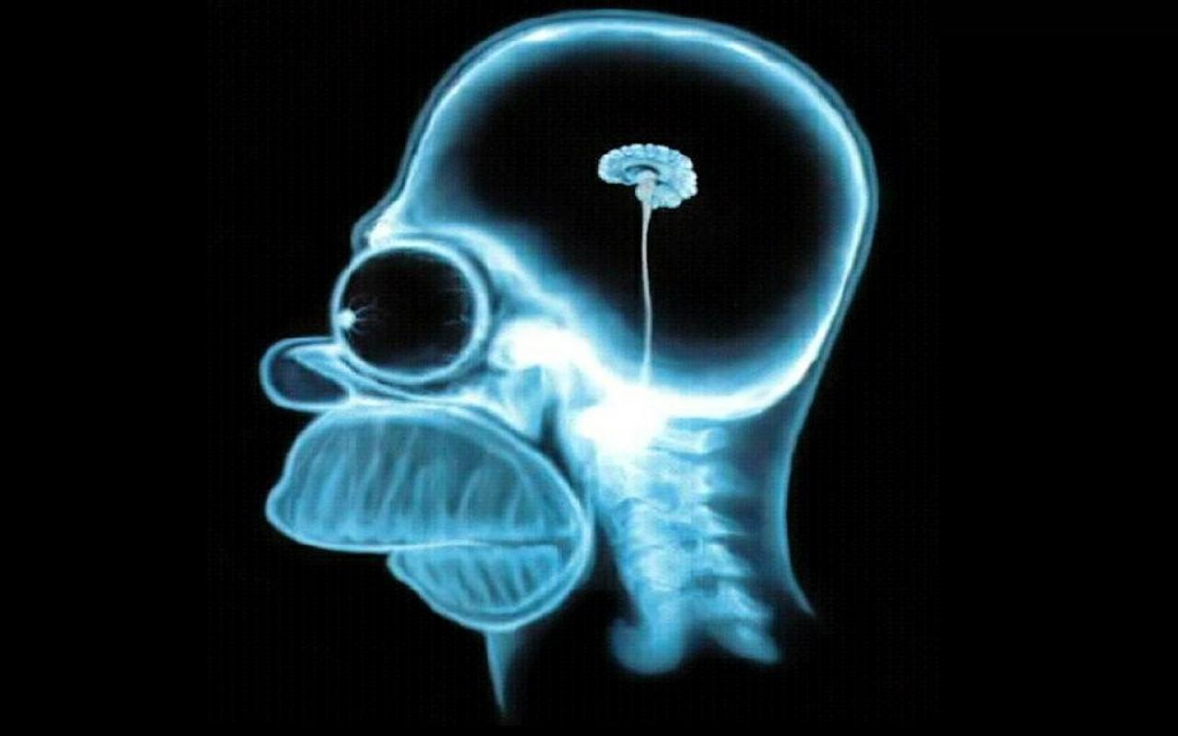

Slide 10
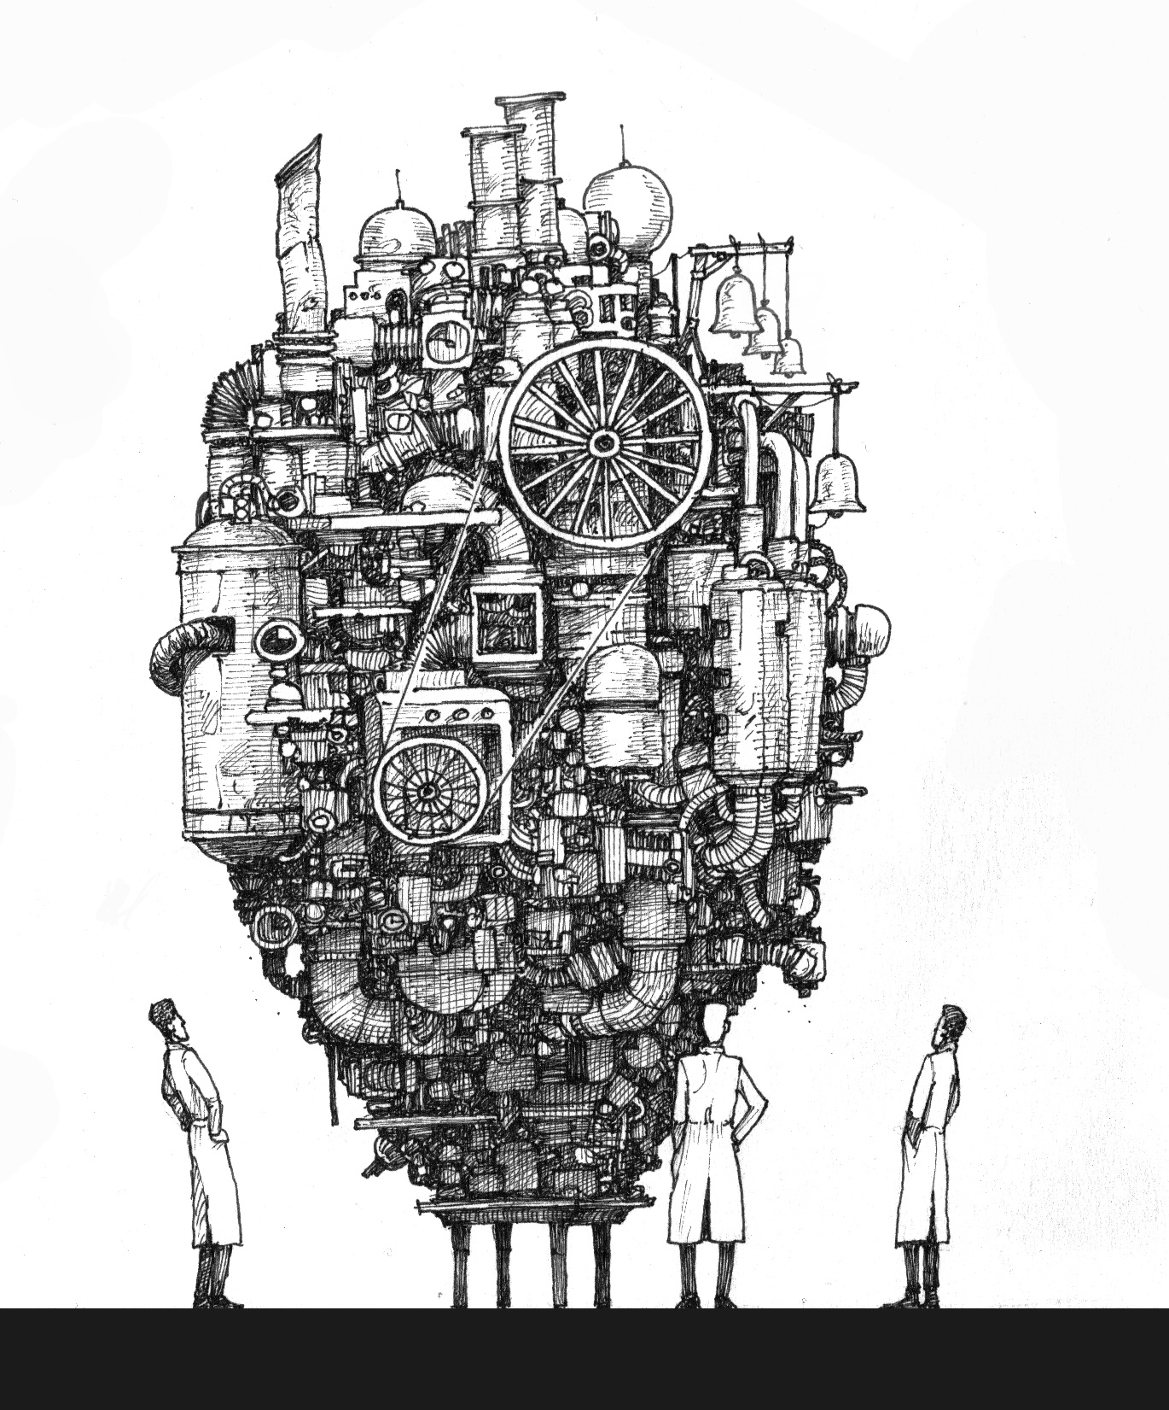

Slide 11
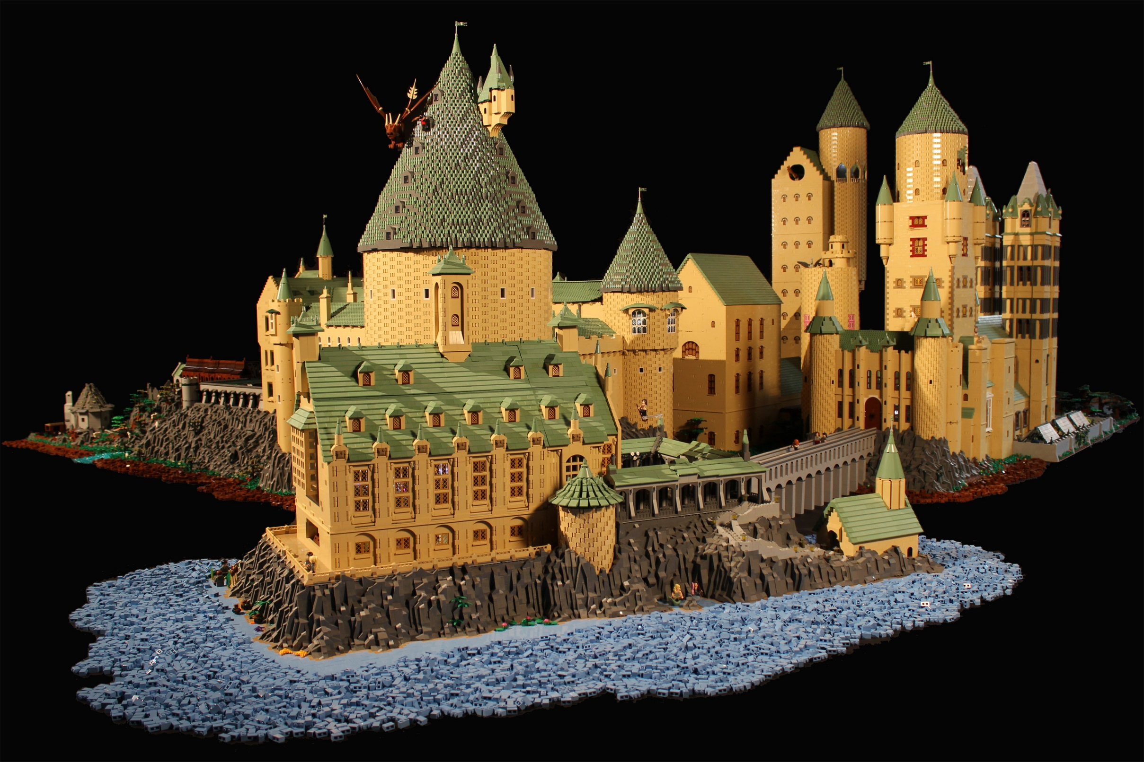

Slide 12
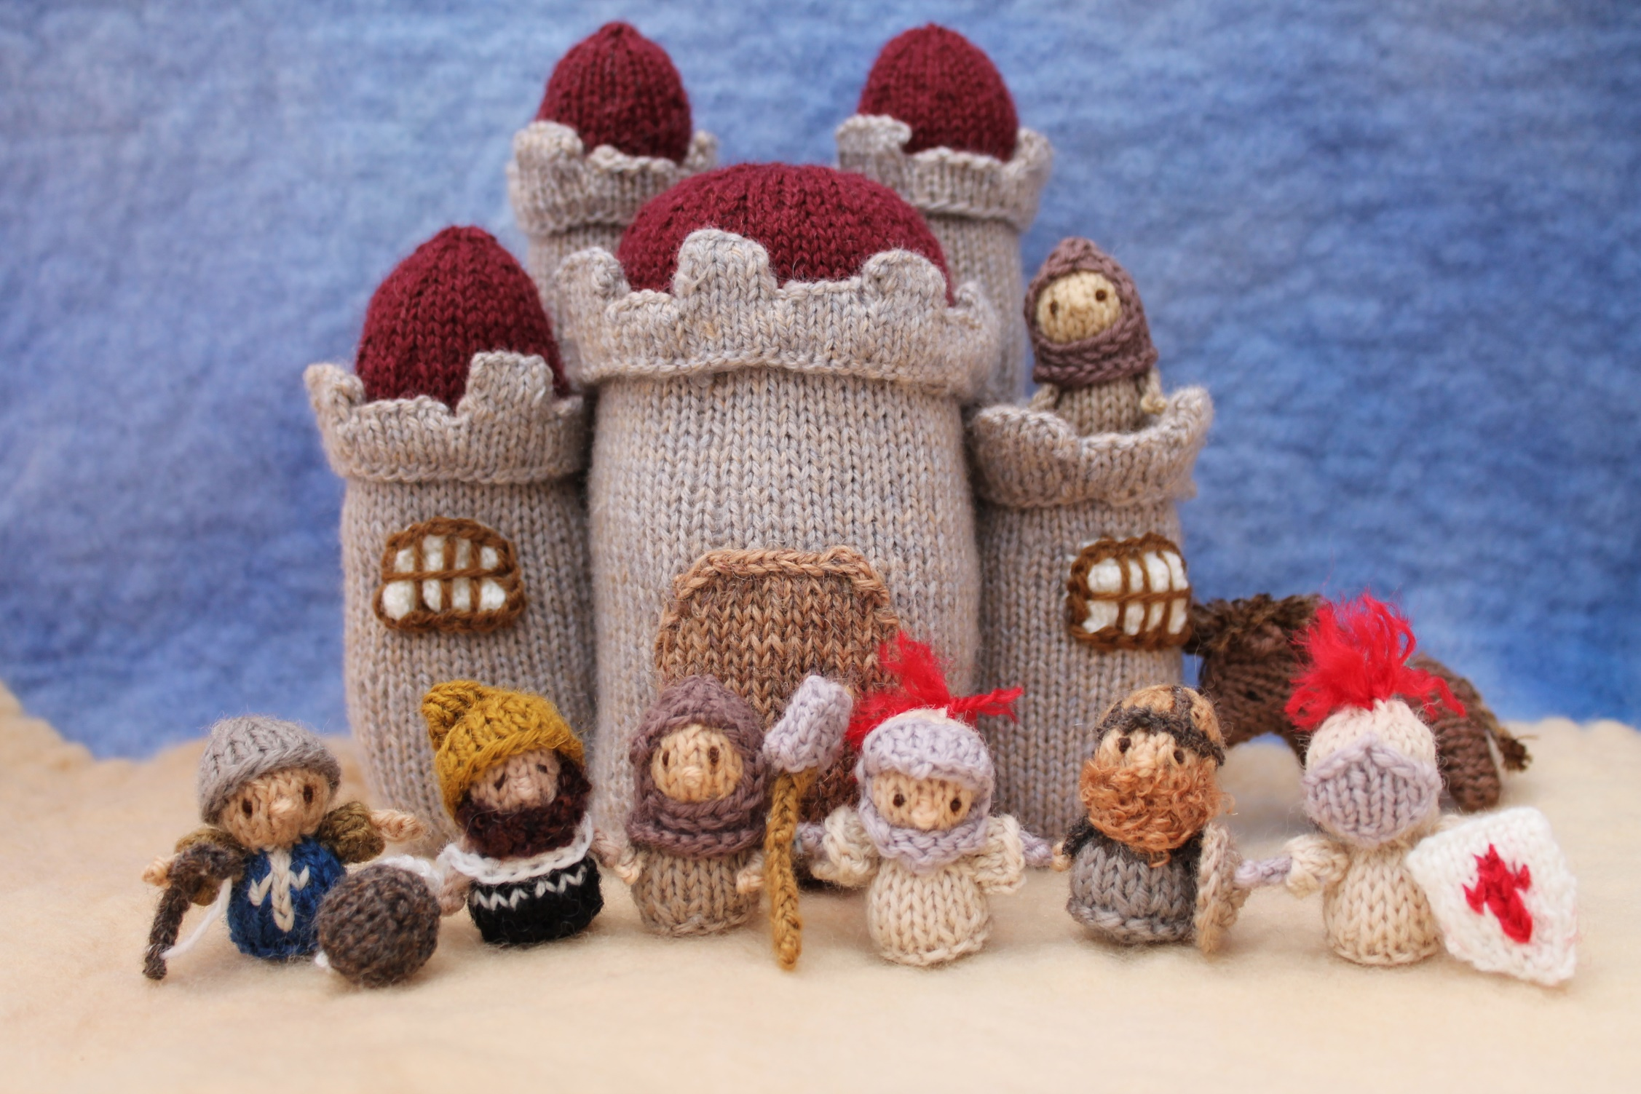

Slide 13
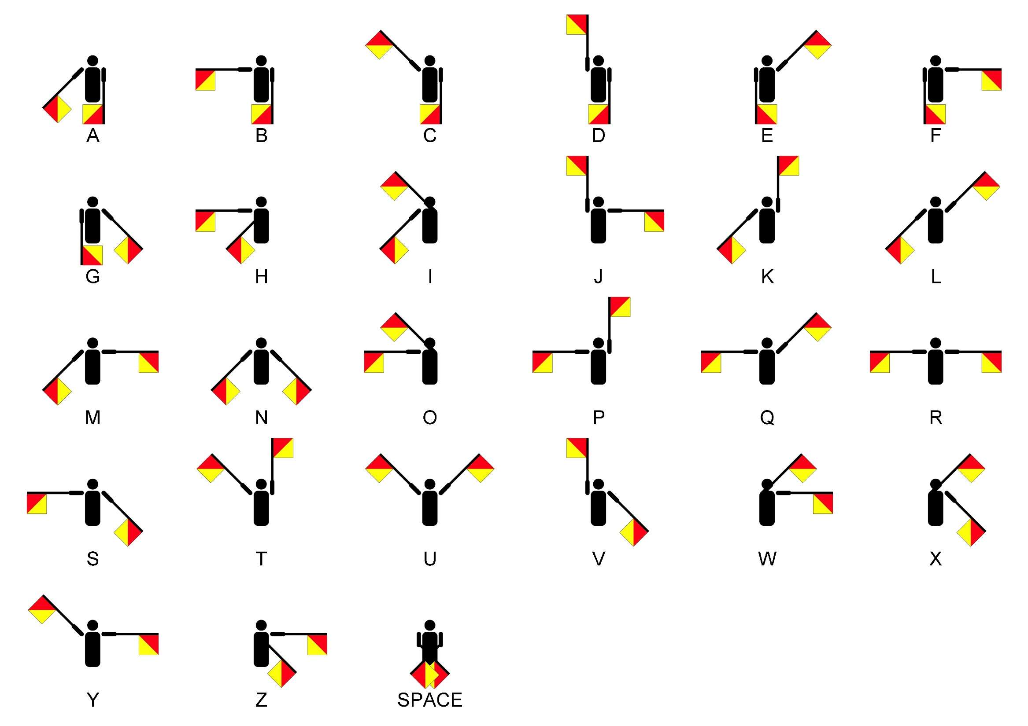

Slide 14
f(x) = (x+1)(x+2)
def f(x):
x = x + 1
y = x + 1
return x * y

Slide 15
f(x) = (x+1)^2
def f(x):
y = x + 1
x = x + 1
return x * y

Slide 16
f(x) = (x+1)(x+2)
def f(x):
x’ = x + 1
y = x’+ 1
return x’ * y

Slide 17
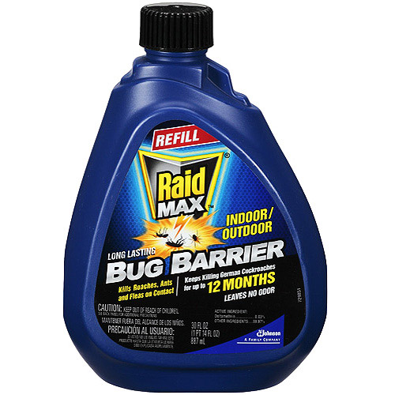

Slide 18
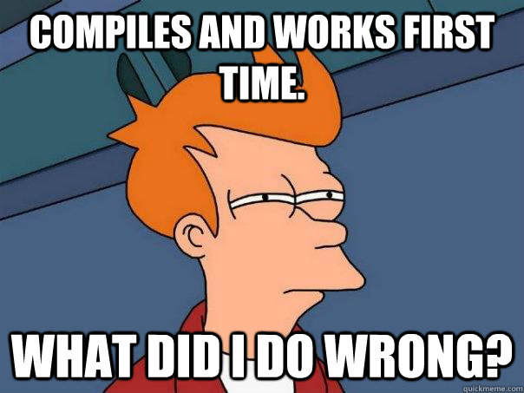

Slide 19


Slide 20
